Slide 1
REGULAR EXPRESSIONS
(ReGex)

Slide 2
What is it?!
What is Regex? | Regex Uses
Regular Expressions are a group of characters or symbols, which are used to find a specific pattern in text. | Form validation SQL queries NLP

Slide 3

Real Life Scenario
Tom’s job is to read through online reviews and contact customers who left a phone number on their customer’s review page.
Some reviews are long and draggy. Tom has no patients to read through several paragraphs to find phone numbers.
Example:
review = 'I have called the service desk 100 times and nobody replies to me. I need a conversation ASAP!! My number is 111-1234567! I expected better service!! Call back fast. Thanks. Have a great day.'
With regex, Tom could easily extract the phone numbers from the reviews

Slide 4
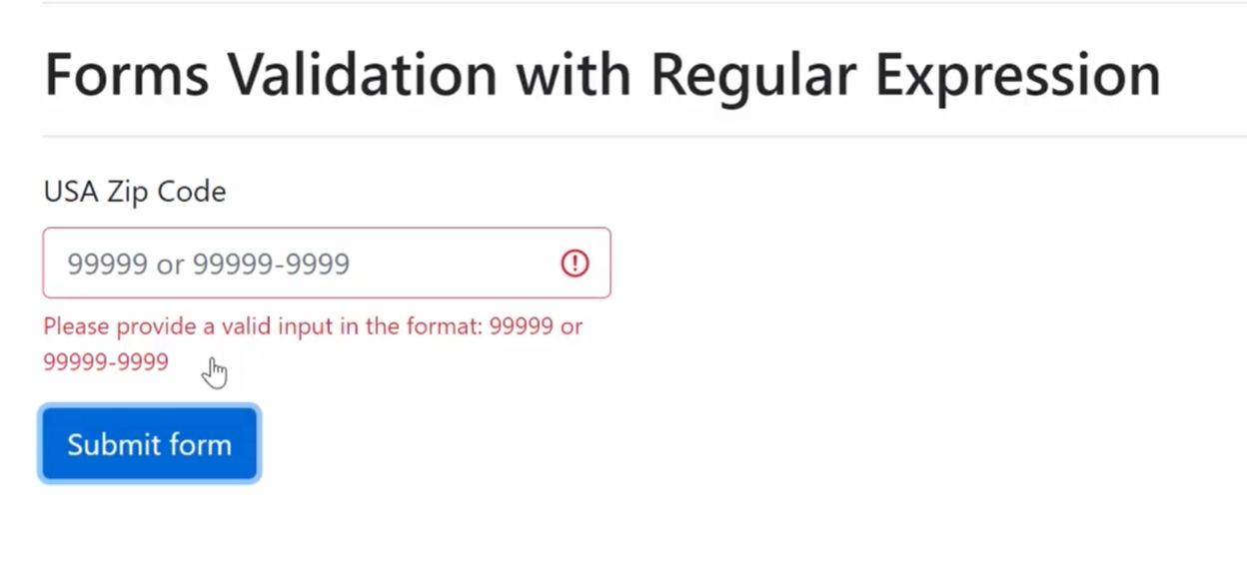
Forms Validation

Slide 5
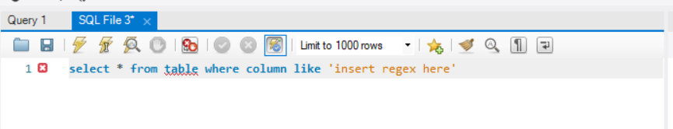
SQL Query

Slide 6
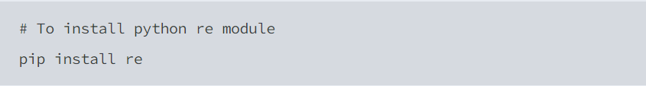
https://docs.python.org/3/library/re.html
Link to Documentation
Regex uses Python’s re module

Slide 7
Methods
Sets
Ranges
Quantifiers

Slide 8
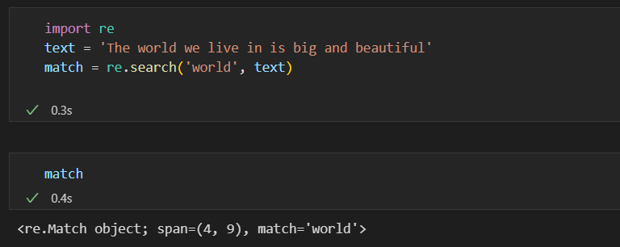
Methods Example of a method
re.search()
Find match anywhere in the text string. Returns the first match found in the statement. If a match is found, match object is returned.

Slide 9
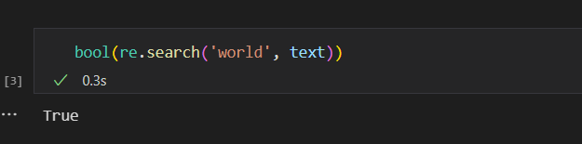

Slide 10
More Regex Methods
re.match() | re.findall() | re.span() | re.start() | re.end() | re.group()
Returns a match if found at the beginning of the string | Returns all instances of matches found in the string | Returns the position where the match is found in the statement Eg. (4, 12) | This method returns the start position of the match that was found in the statement. | This method returns the end position of the match that was found in the statement. | This method returns the word that is being matched with the pattern in the statement

Slide 11
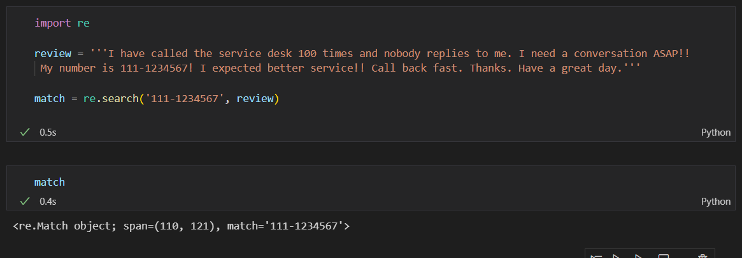
Back to Tom
How can he use regex to find the phone number?
review = 'I have called the service desk 100 times and nobody replies to me. I need a conversation ASAP!! My number is 111-1234567! I expected better service!! Call back fast. Thanks. Have a great day.'

Slide 12
BUT HOW CAN REGEX HELP TOM IF HE DOESN’T KNOW THE PHONE NUMBER?
Identifiers & Quantifiers

Slide 13
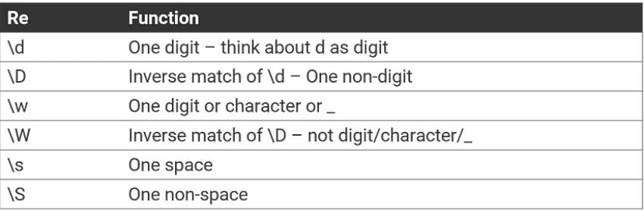
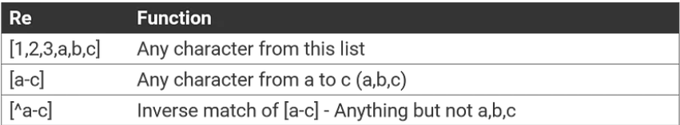
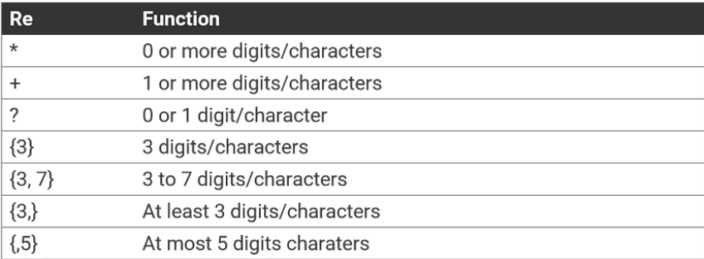
Sets, Ranges
&
Quantifiers

Slide 14
Sets, ranges & Quantifiers
EXAMPLES
match = re.search(r'[Ee]mail')
match = re.search(r'[A-Z]mail')
match = re.search(r'a{3,5}')
match = re.search(r'a*')
match = re.search(r'a+')
match = re.search(r'a?')

Slide 15
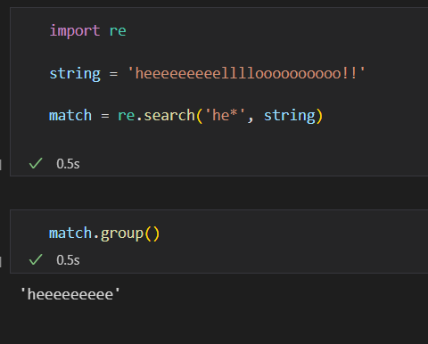
Sets, ranges & Quantifiers
EXAMPLES
match = re.search(r'[Ee]mail')
"Email", “email”
match = re.search(r'[A-Z]mail')
“Gmail”, “Email”
match = re.search(r'a{3,5}')
“aaa”, “aaaa”, “aaaaa”
match = re.search(r'a*')
0 or more occurrences of the pattern to its left
match = re.search(r'a+')
1 or more occurrences of the pattern to its left
match = re.search(r'a?')
0 or 1 occurrences of the pattern to its left

Slide 16
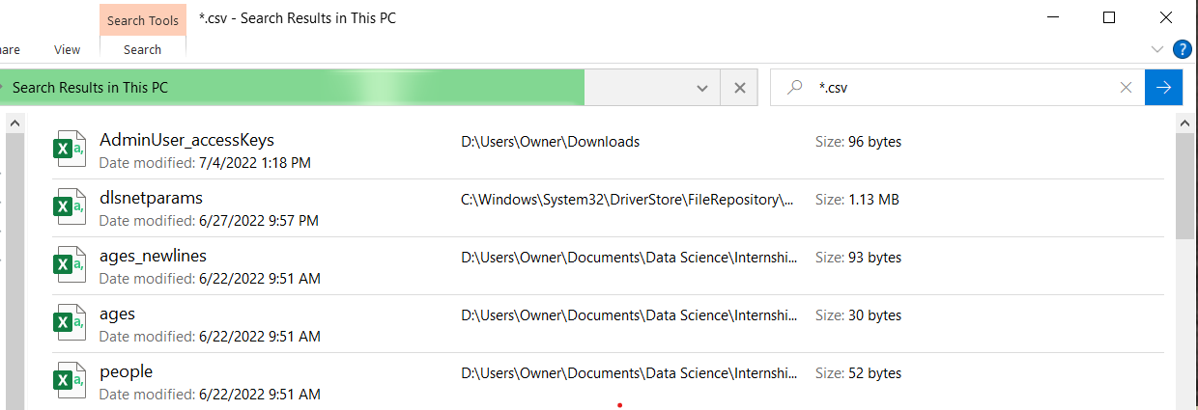
Quick Task
Try this in your file explorer:
Use regex to search for desired files

Slide 17
Escape Characters
To match a character having special meaning in regex, you need to use a escape sequence prefix with a backslash ( \ ). ...
You also need to use regex \\ to match "\" (back-slash).
EXAMPLE:
To match [PDF] surrounded by brackets:
Pattern = r’\[PDF\]
Otherwise regex will see it as a set [PDF] and look for a P, D or F

Slide 18
Easy Practice
Let’s write a regex to match and three letter word any five letter word.

